Slide 1
Ios workshop
MadE by PLT ios team ©2017

Slide 2
agenda
INTRODUCTION
NAVIGATION View controller
Split view controller
Tab bar controller
Table view controller
Collection view controller
Page view controller

Slide 3
agenda
INTRODUCTION
NAVIGATION View controller
Split view controller
Tab bar controller
Table view controller
Collection view controller
Page view controller

Slide 4
NAVIGATION View Controller
What is NAVIGAION VIEW CONTROLLER?
Why DO we need IT?
What are the benefits of using it?

Slide 5
NAVIGATION View Controller
THE concept of NAVigation View controller
Navigation view controller embed others view controllers views in its view allowing us to easily navigate (browse) through them.
Navigation VC is the great tool for splitting one large MVC to several MVCs. Navigation VC ”navigates” us through that complex MVC.
By doing this, it allow us to be focused on the app MCVs and not to be worried about navigation process itself.

Slide 6
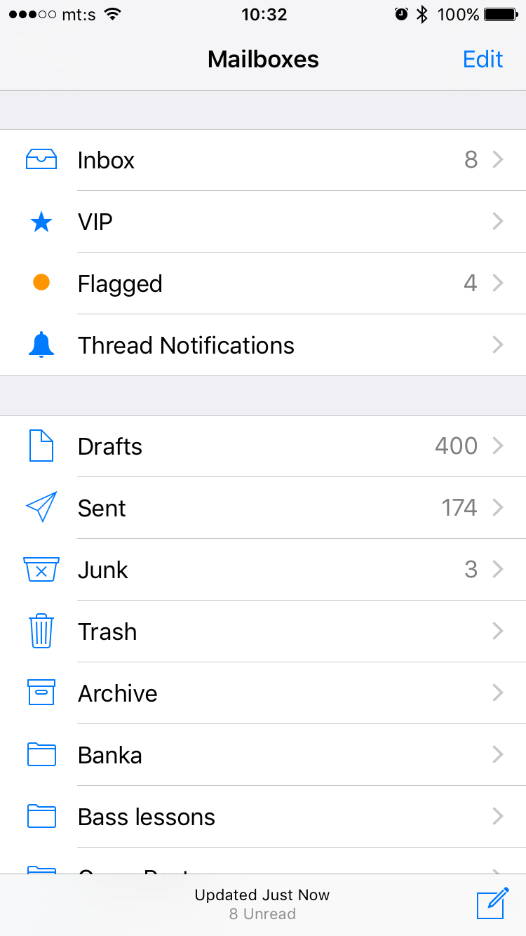
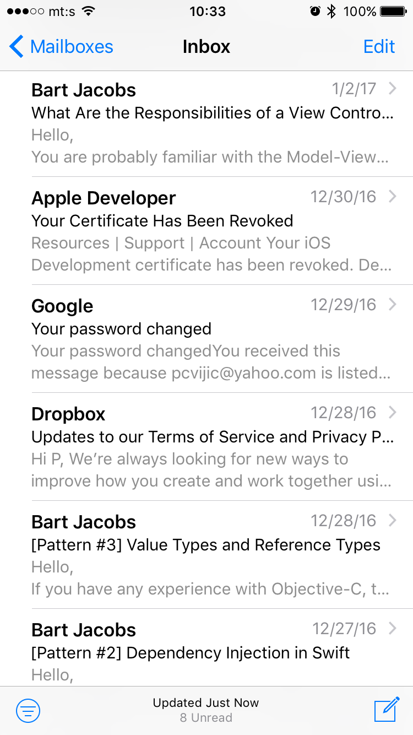
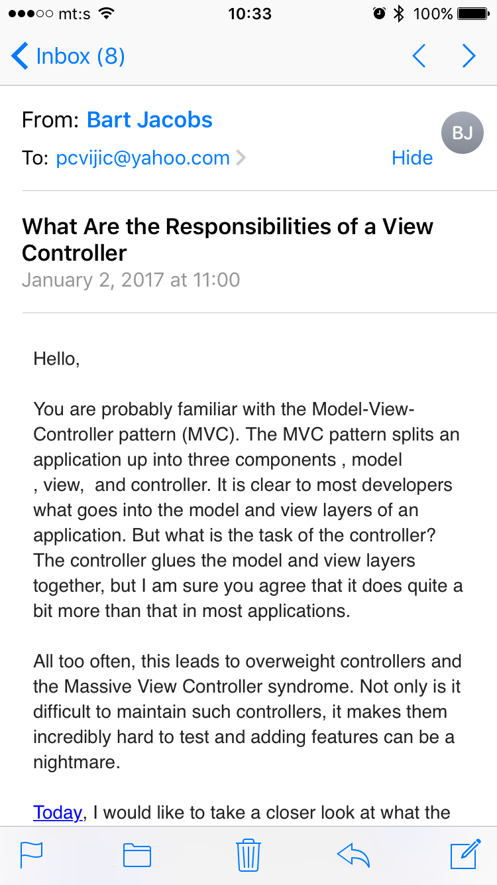
Navigation view controller
Navigation bar
Title
Right navigation bar item
Embedded view
Back bar item
Toolbar
Toolbar item
All marked items are drawn by NVC but the content is defined by the MVC currently showing!

Slide 7
NAVIGaTION VIEW cONTROLLER
NAVIGATION VIEW CONTROLLER’s components – how to access them?
NAVIgation bar
Toolbar
self.navigationItem.title
self.navigationItem.backBarButtonItem
self.navigationItem.leftBarButtonItem(s)
self.navigationItem.rightBarButtonItem(s)
self.toolbarItems
TXT

Slide 8
NAVIGATION View Controller
NVC as stack of view controllers
Regarding the stack, we can:
Push a VC to stack
Pop a VC from stack
Pop directly to any VC from the stack
Each of these operations results in presenting the VC
REMARKS:
Pushing VC to stack leaves all the VCs alive
Popping VC from stack deallocates all the VCs above it

Slide 9
NAVIGATION VIEW CONTROLLER
navigation from code
Push view controller
navigationController.pushViewController(viewController: UIViewController, animated: Bool)
Pop view controller
navigationController.popViewController(animated: Bool)
navigationController.popToRootViewController(animated: Bool)
navigationController.popToViewController(viewController: UIViewController, animated: Bool)
Direct access to embedded VCs
navigationController.viewControllers (array of UIViewControllers)
navigationController.visibleViewController
navigationController.topViewController
Notes:
-

Slide 10
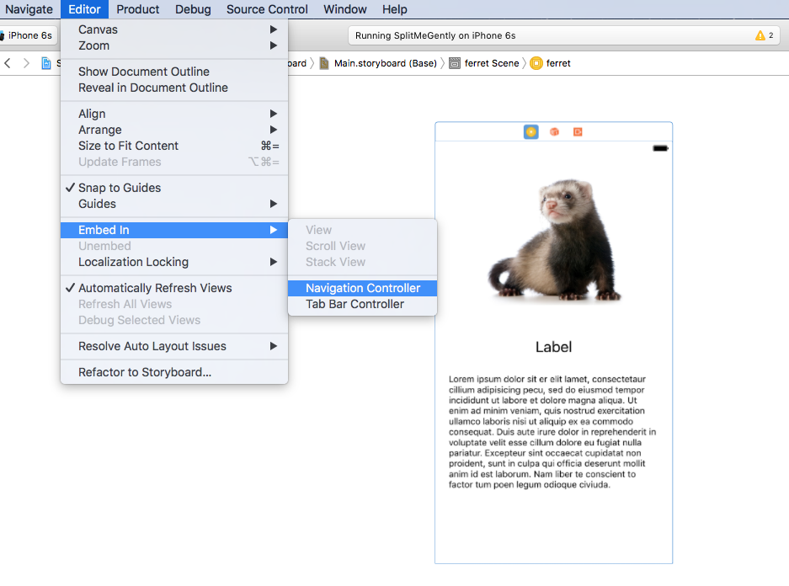
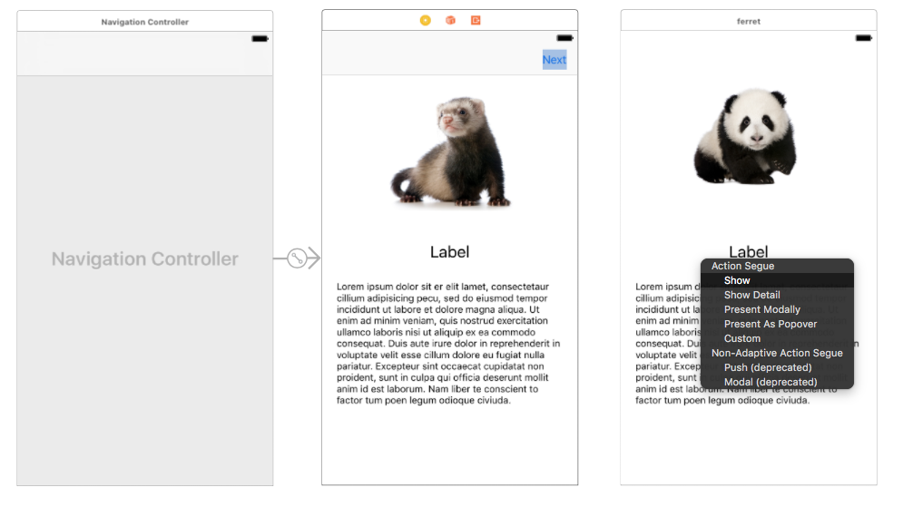
NAVIGATION VIEW CONTROLLER
navigation from STORYBOARD
Every VC can be easily embedded in navigation view controller
Editor -> EmbedIn -> Navigation Controller
Now on, you can simply create segues to another VC. You still have to provide a VC preparation in prepare(for segue: UIStoryboardSegue, sender: Any?) method.
Note that your destination VC is embedded in navigation VC. One must first get the navigation VC then get out the visible navigation view controller

Slide 11
NAVIGATION VIEW CONTROLLER
EXAMPLE 1
Navigation VC

Slide 12
agenda
INTRODUCTION
NAVIGATION View controller
Split view controller
Tab bar controller
Table view controller
Collection view controller
Page view controller

Slide 13
SPLIT View Controller
What is SPLIT VIEW CONTROLLER?
Why DO we need IT?
What are the benefits of using it?

Slide 14
SPLIT View Controller
THE concept of SPLIT View controller
The split view lets you carve up the screen into two sections and display a view controller on each side.
It can be used to display navigation on the left side, and a detail view on the right side.
It allow us to easily visualize both current navigation position and content at that position.

Slide 15
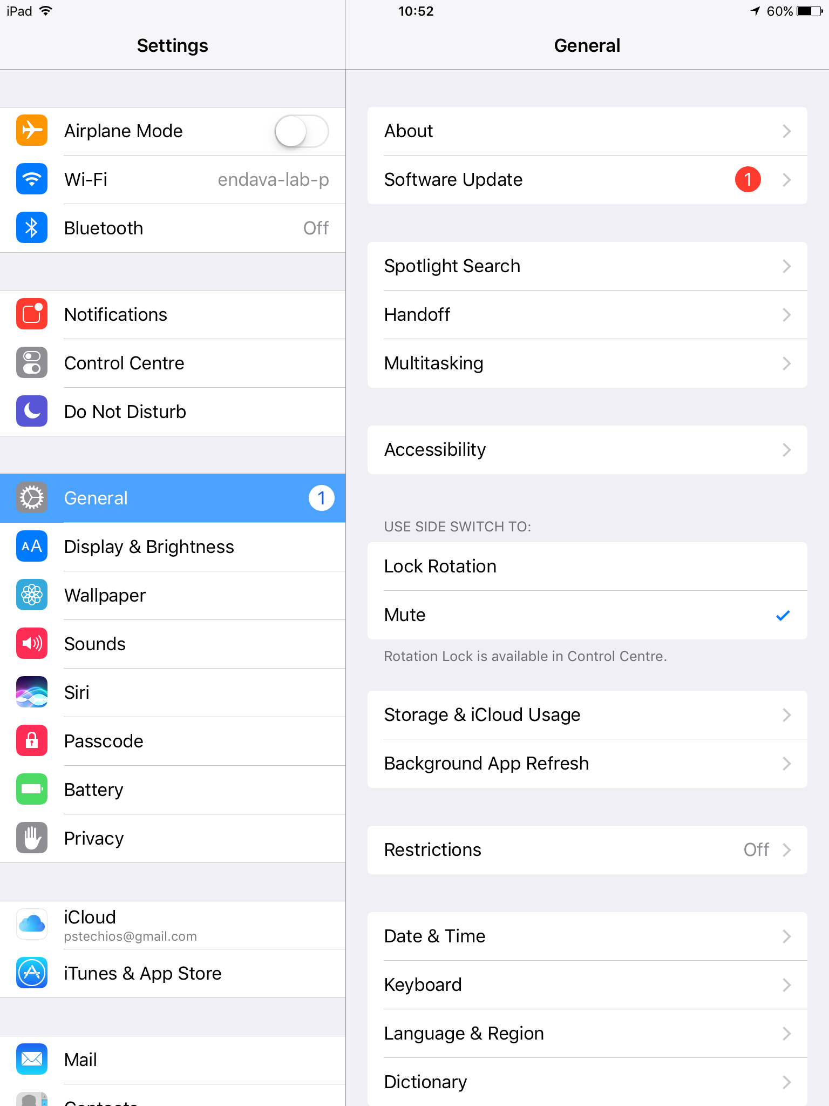
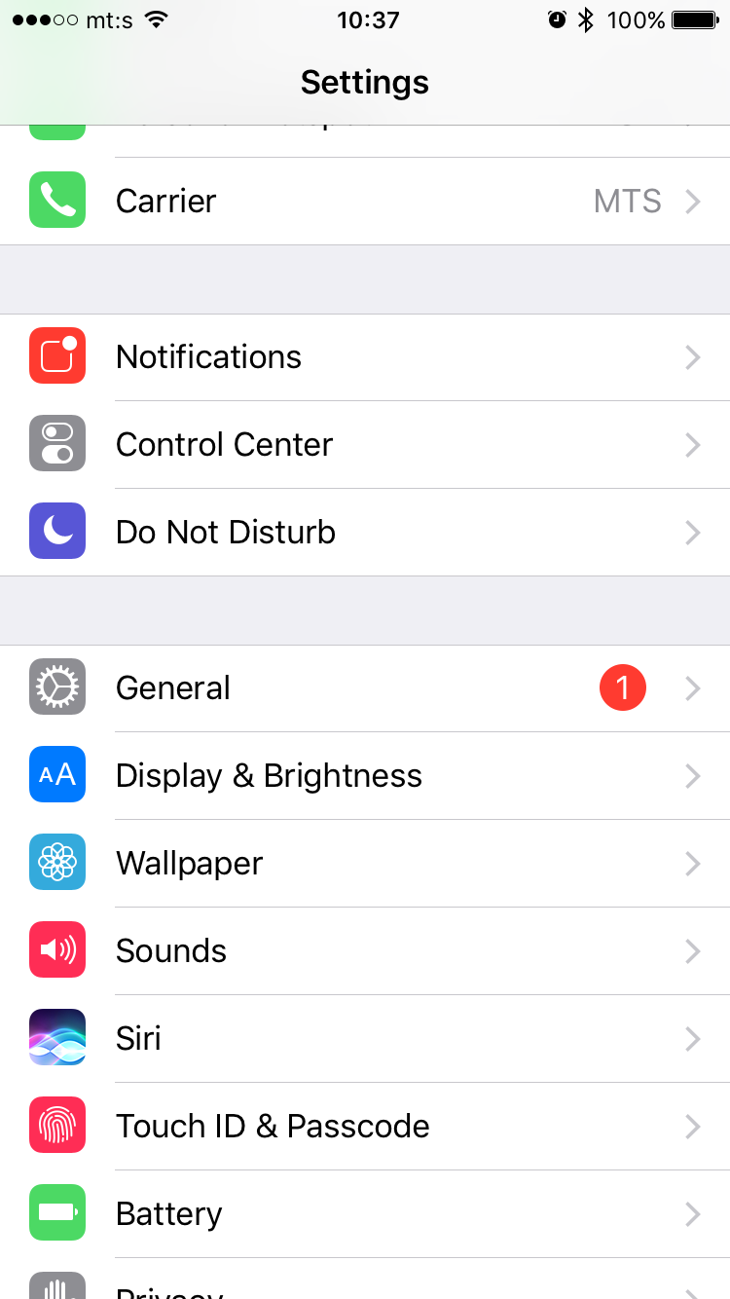
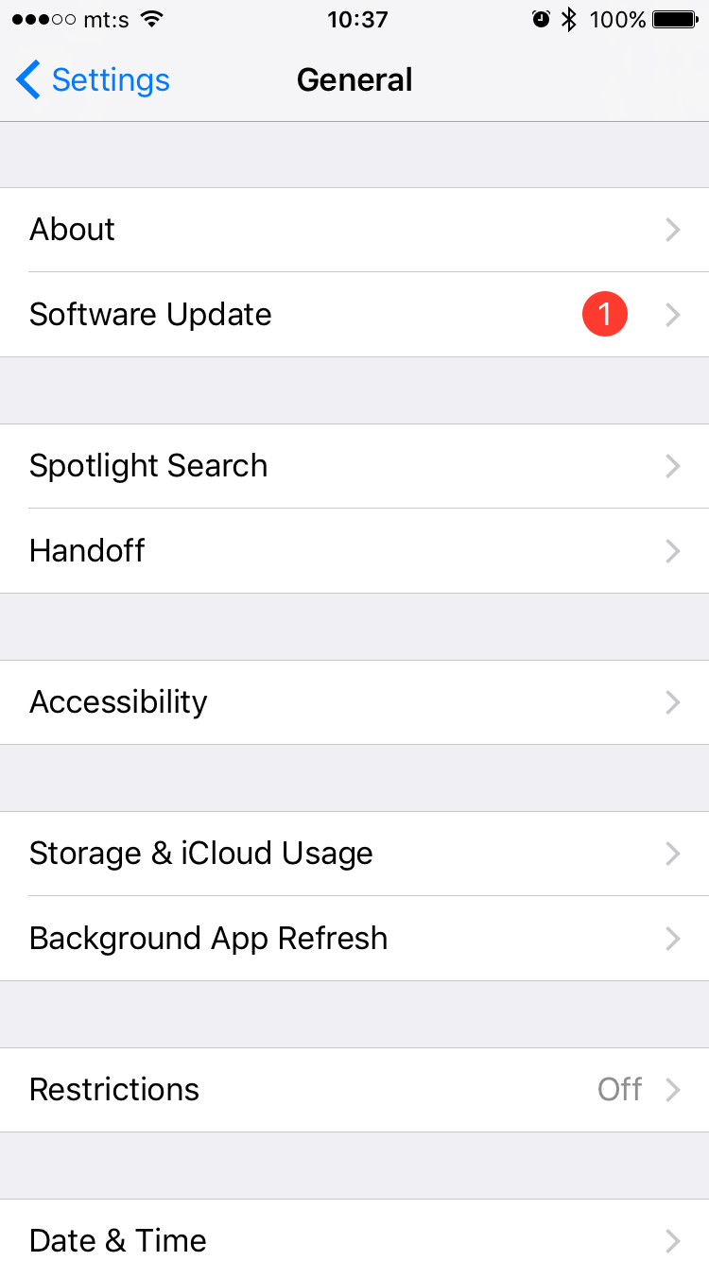
SPLIT View Controller
Master VC
Detail VC
Master VC
Detail VC
iPad (regular width)
iPhone 6s (compact width)
Single screen
Two screens

Slide 16
SPLIT View Controller
UNIVERSAL SPLIT View controller
Split VC can be easily tweaked to be used on both iPhones and iPads
In that case, master VC must be embedded in navigation VC
Any segue going from master to detail VC must be of “Show Detail” type
Hint: Dragging Split View Controller from Object Library to storyboard makes master VC automatically embedded in Navigation VC

Slide 17
SPLIT View Controller
SPLIT View controller - FACTS
Master VC is instantiated only once.
Detail VC is instantiated every time we segue to it.
!!! The previous presented detail VC is deallocated !!!
Any VC can access to its split VC (if exist) using its property splitViewController.

Slide 18
SPLIT VIEW CONTROLLER
EXAMPLE 2
Split me gently

Slide 19
agenda
INTRODUCTION
NAVIGATION View controller
Split view controller
Tab BAR controller
Table view controller
Collection view controller
Page view controller

Slide 20
TAB BAR Controller
What is TAB BAR CONTROLLER?
Why DO we need IT?
What are the benefits of using it?

Slide 21
TAB BAR Controller
THE concept of TAB BAR controller
The tab bar controller manages multiple MVCs providing a radio-style selection interface.
Tab bar controller is ideal to use when there’s need to present different types of information or to present the same information using a completely different style of interface.
It allow us to quickly group multiple MVCs in a manner that provides easy of use and access.
“Out of sight, out of mind”

Slide 22
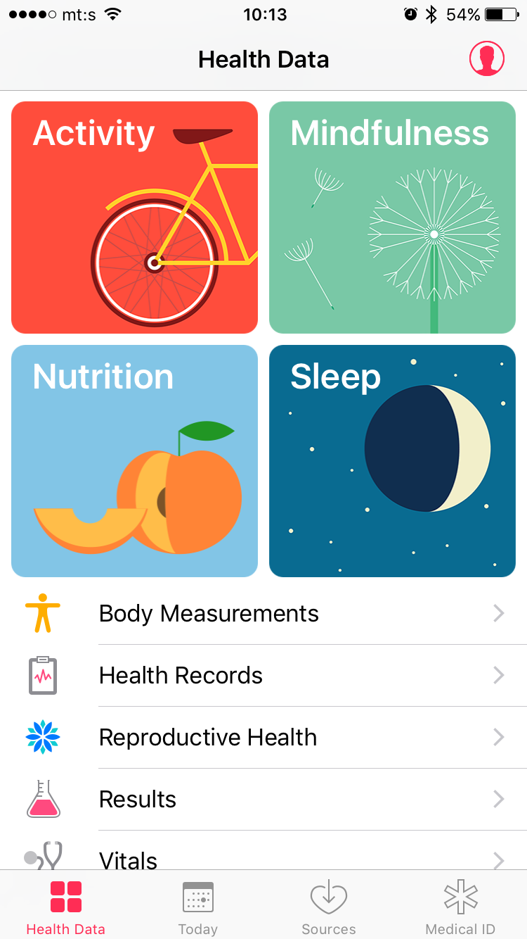
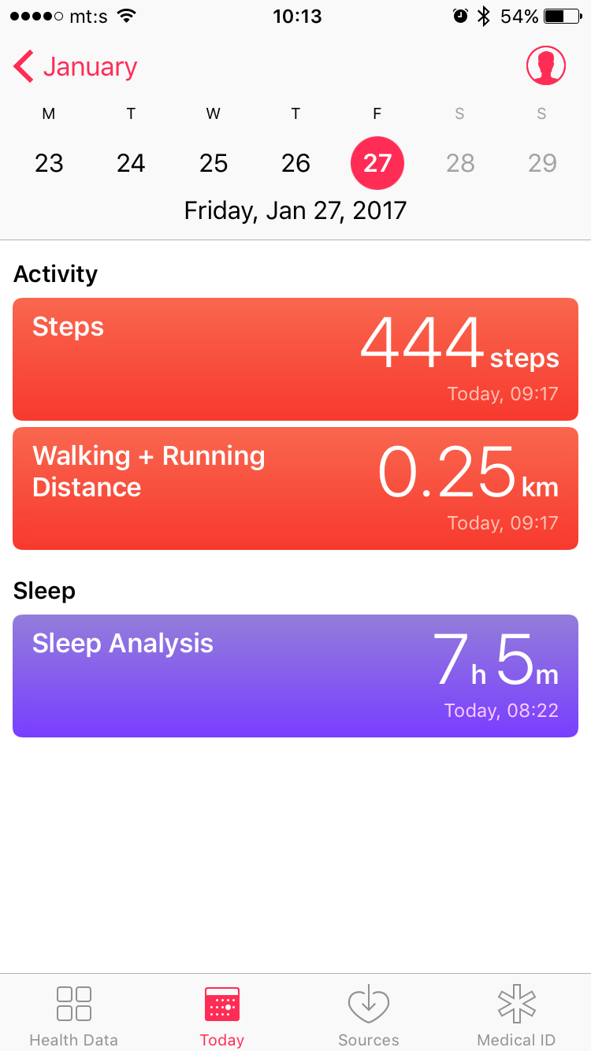
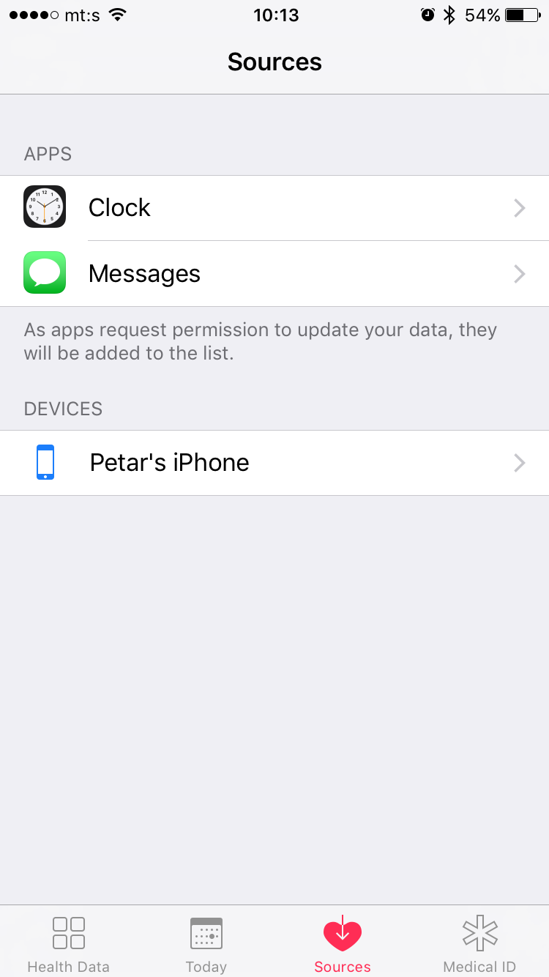
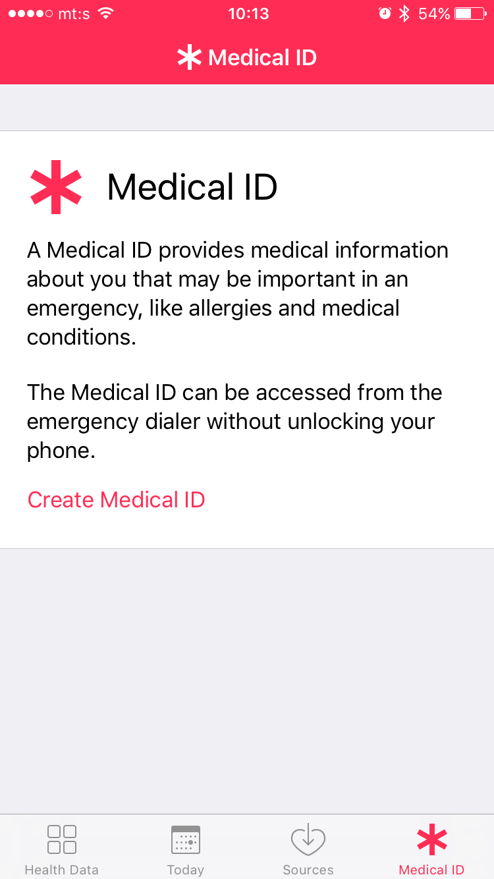
TAB BAR Controller
Tab bar Item
Tab bar
Selected tab bar item
All marked items are drawn by TBC but the content is defined by the MVC currently showing!

Slide 23
TAB BAR cONTROLLER
TAB BAR CONTROLLER components
Tab bar controller
Tab bar item
self.tabBarController.viewControllers
self.tabBarController.selectedIndex
self.tabBarController.selectedViewController
self.tabBarItem.title
self.tabBarItem.image
self.tabBarItem.selectedImage
self.tabBarItem.badgeValue
self.tabBarItem.badgeColor
TXT

Slide 24
TAB BAR cONTROLLER
TAB BAR CONTROLLER DELEgate
UITabBarControllerDelegate - delegate is used to control how the tab bar controllers is displayed
func tabBarController(_ tabBarController: UITabBarController, shouldSelect viewController: UIViewController) -> Bool
Should we present a selected VC from the tab bar?
func tabBarController(_ tabBarController: UITabBarController, didSelect viewController: UIViewController)
We did select a VC from tab bar, do something in that case.
… and many more
TXT

Slide 25
TAB BAR Controller
TAB BAR controller - FACTS
All VCs are instantiated only once so viewDidLoad is call only once. If there is any job that must be executed each time VC is presented, you must put it somewhere else, e.g. in viewWillAppear.
Going from one to another VC in TBC does not deallocate previous selected VC.
There can be max five items on the tab bar. In case of more than five items, special more item is added automatically.

Slide 26
TAB BAR CONTROLLER
EXAMPLE 3
CLOCK app

Slide 27
agenda
INTRODUCTION
NAVIGATION View controller
Split view controller
Tab bar controller
Table view controller
Collection view controller
Page view controller

Slide 28
TABLE View Controller
What is TABLE VIEW CONTROLLER?
Why DO we need IT?
What are the benefits of using it?

Slide 29
TABLE View Controller
THE concept of TABLE View controller
Table view controller is responsible for managing a table view (UITableView).
Table view is a UIView element used for displaying and editing a list of items.
It allow us to easily manage large datasets in the user friendly and iOS native style.

Slide 30
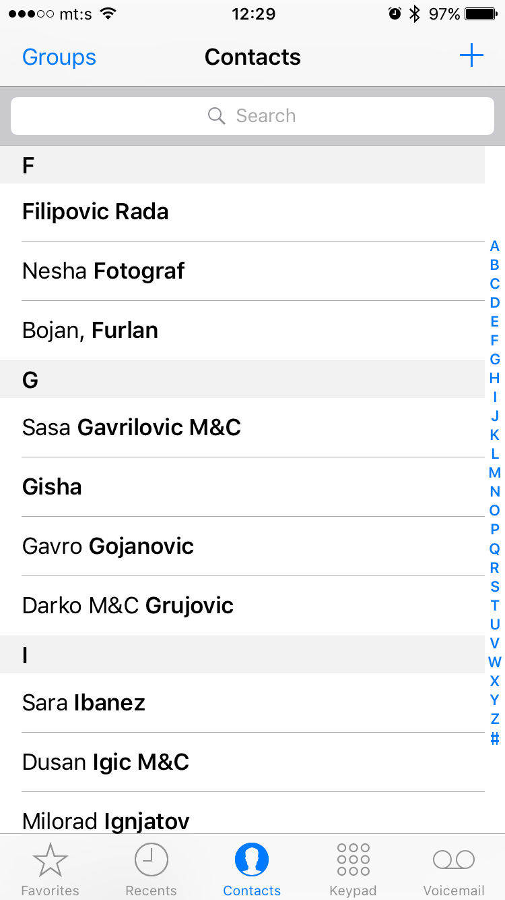
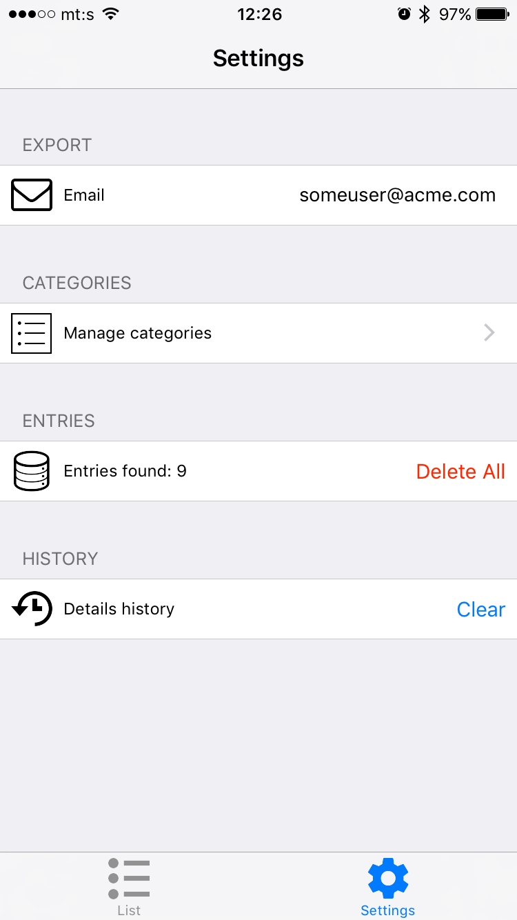
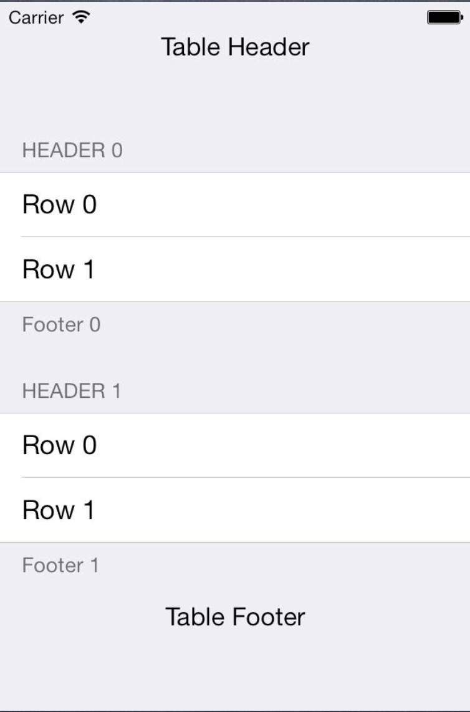
TABLE View Controller
Dynamic
&
Plain
Static
&
Grouped
Table cell
Section
Section
Section header
Section header
Row
Section

Slide 31
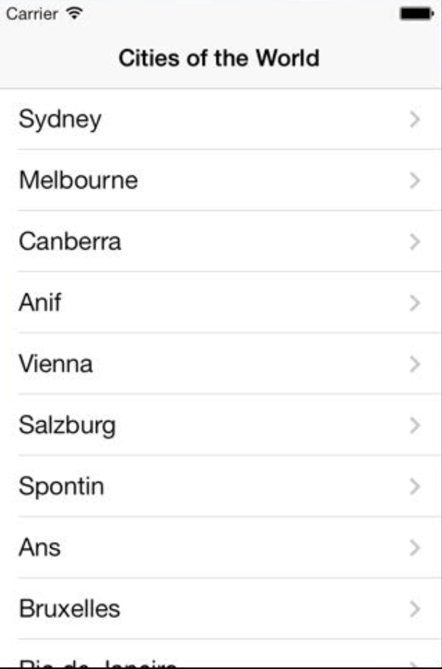
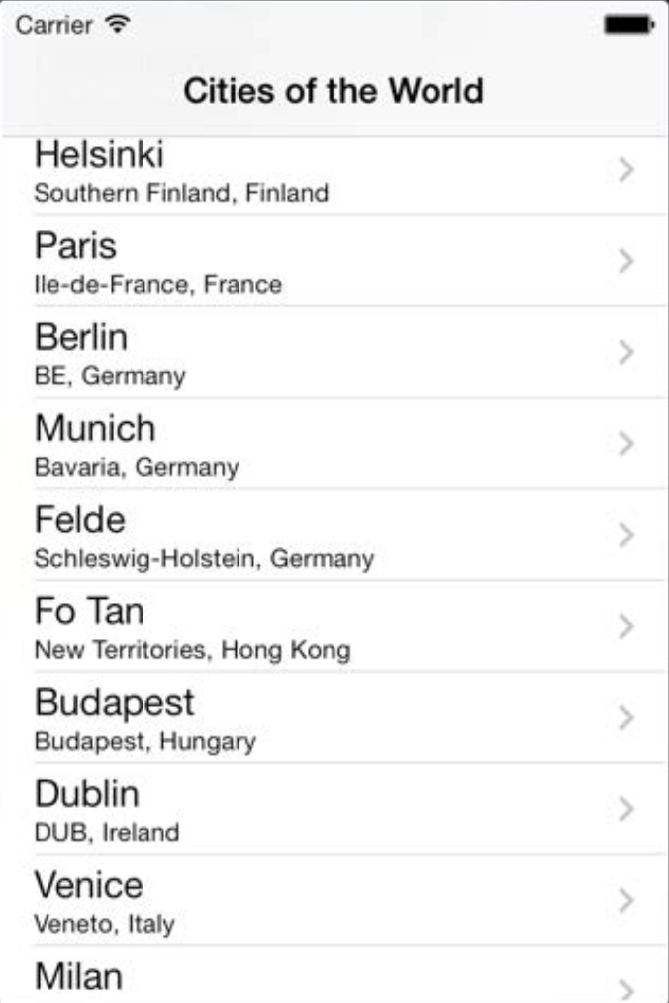
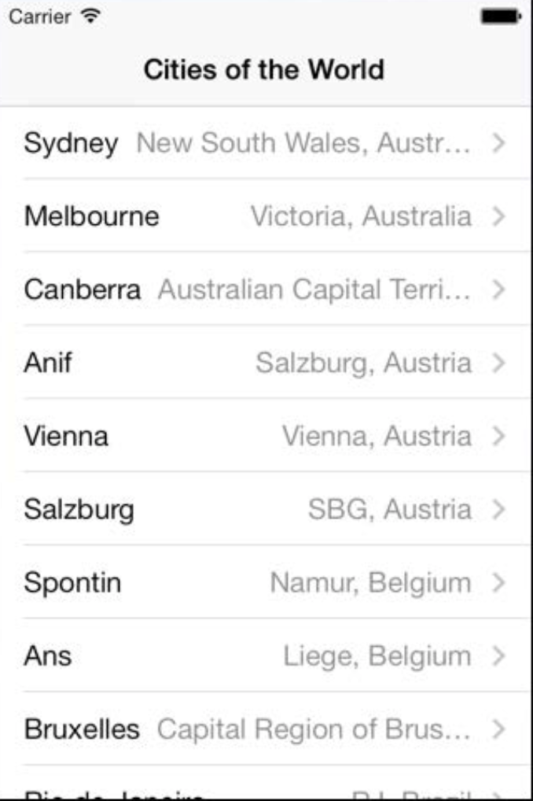
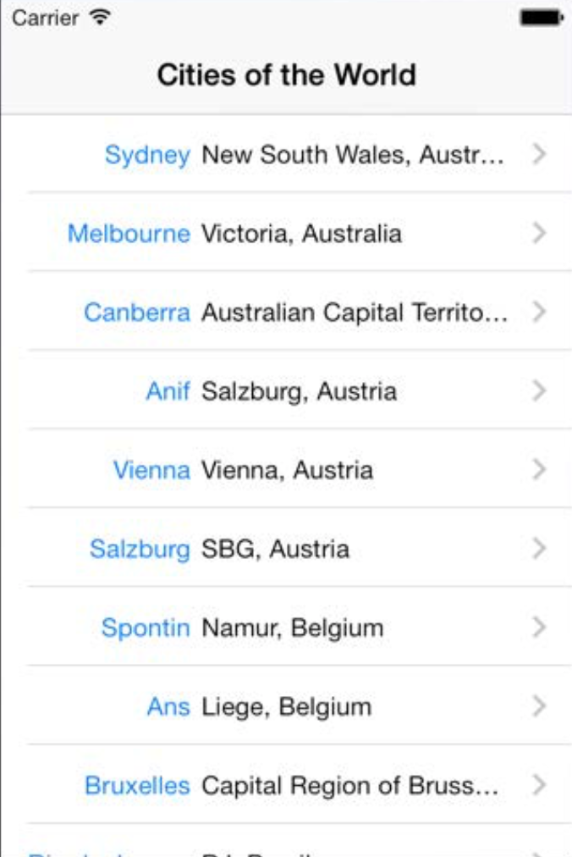
TABLE View Controller
Table cell Types
Basic
Subtitle
Right Detail
Left Detail

Slide 32
TABLE View Controller
UITableview protocols
In order to manage UITableView, the corresponding VC must become UITableView’s dataSource and delegate:
The delegate is used to control how the table is displayed
The dataSource provides the data displayed inside the cells
UITableViewController automatically sets itself as the UITableView’s delegate and datasource
Notes:
-

Slide 33
TABLE View Controller
UITableview DAtasource
There are three important methods in the datasource protocotol that provide us:
The number of sections in the table (deafult is 1 if not implemented)
func numberOfSections(in tableView: UITableView) -> Int
The number of rows in each section (required)
func tableView(_ tableView: UITableView, numberOfRowsInSection section: Int) -> Int
The UIView to use to draw each cell (at a given row in a given section)
func tableView(_ tableView: UITableView, cellForRowAt indexPath: IndexPath) -> UITableViewCell

Slide 34
TABLE View Controller
UITablevieWCELL
UITableViewCell is the subclass of UIView used to draw each row.
Table cell are reused as rows appear and disappear
Every UITableViewCell must have unique identifier used for cell reusing
let cell = tableView.dequeueReusableCell(withIdentifier: ”uniqueId", for: indexPath)

Slide 35
TABLE View Controller
Indexpath
Let’s look at IndexPath as a simply as struct representing the “coordinates” of the cell in the table list. The struct has two public properties we are interested in:
indexPath.section
indexPath.row

Slide 36
TABLE View Controller
UITableview Delegate
The delegate reacts to user actions, provides permissions and observes what the table view is doing. Some examples:
Action - selection of the row
func tableView(_ tableView: UITableView, didSelectRowAt indexPath: IndexPath)
Permission – editing the row
func tableView(_ tableView: UITableView, canEditRowAt indexPath: IndexPath) -> Bool
Observation – the row is no more highlighted
func tableView(_ tableView: UITableView, didUnhighlightRowAt indexPath: IndexPath)

Slide 37
TABLE View Controller
Model for tableview - HINTS
Organize your model as multidimensional (2D) array tableModel[numberOfSections][numberOfRows].
Now, datasources are simply:
Number of section - tableModel.count
Number of rows in section m – tableModel[m].count
Data for cell at row k in given section m – tableModel[m][k]
If some section of the model is empty, don’t hesitate to leave that empty array in the 2D array. Don’t worry, your datasources will be still working great.
If we go further this way, titles for section headers (footers) can be also modeled as arrays sectionHeaders[numberOfSections].
When the model is changed, all we need is to call UITableView’s method reloadData()
It causes to call all three mandatory datasources (numberOfSection, numberOfRowsInSection, cellForRowAtIndexPath).
If only a part of the model changes light-weight solution is to reload only certain cells - reloadRowsAtIndexPaths(…)

Slide 38
TABLE VIEW CONTROLLER
EXAMPLE 4
FINANCE app

Slide 39
agenda
INTRODUCTION
NAVIGATION View controller
Split view controller
Tab bar controller
Table view controller
Collection view controller
Page view controller

Slide 40
collection View Controller
What is Collection VIEW CONTROLLER?
Why DO we need IT?
What are the benefits of using it?

Slide 41
COLLECTION View Controller
THE concept of COLLECTION View controller
Collection view controller is responsible for managing a collection view (UICollectionView).
Collection view is a UIView element used for displaying and editing a set of items presented in a grid form.
It allow us to easily manage large datasets in the user friendly and iOS native style.

Slide 42
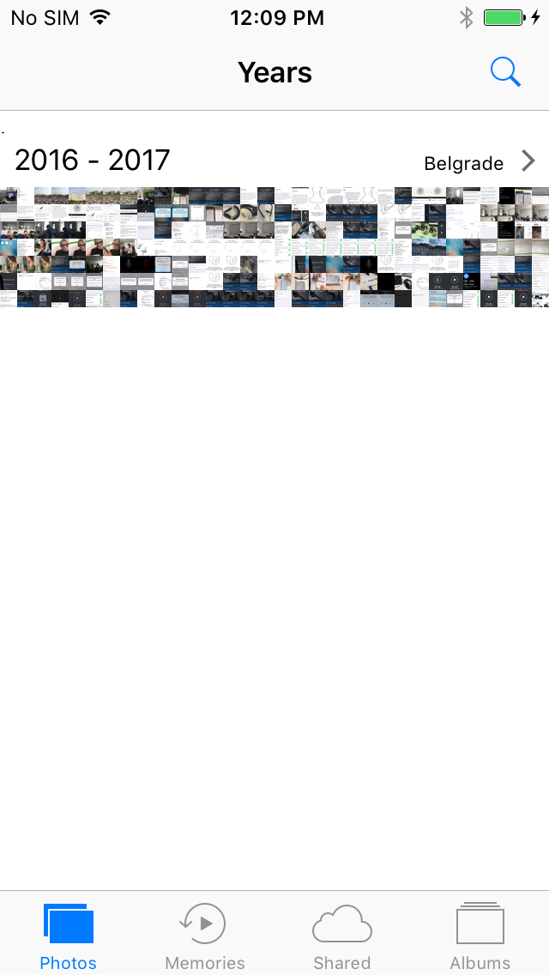
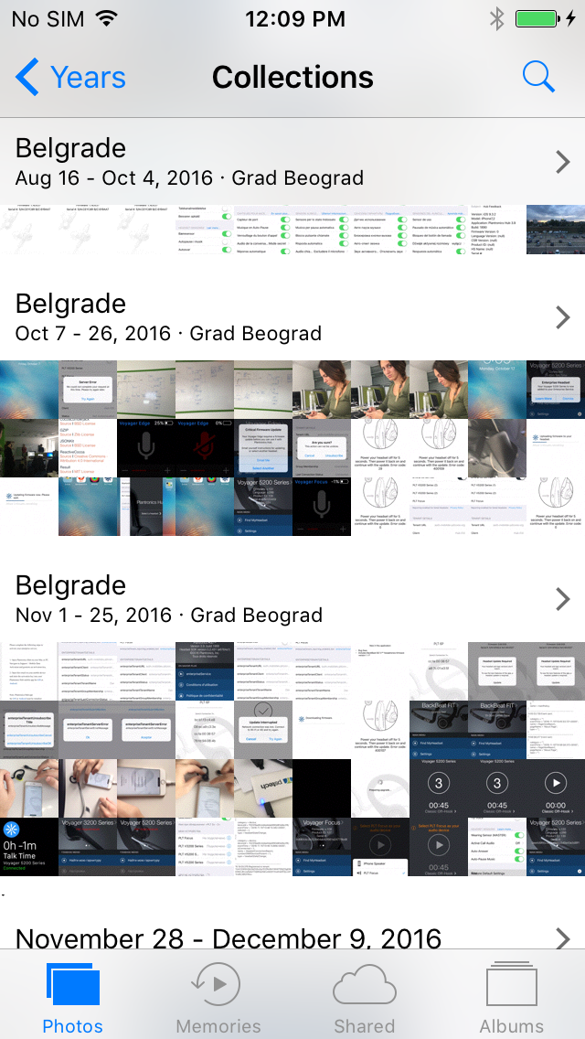
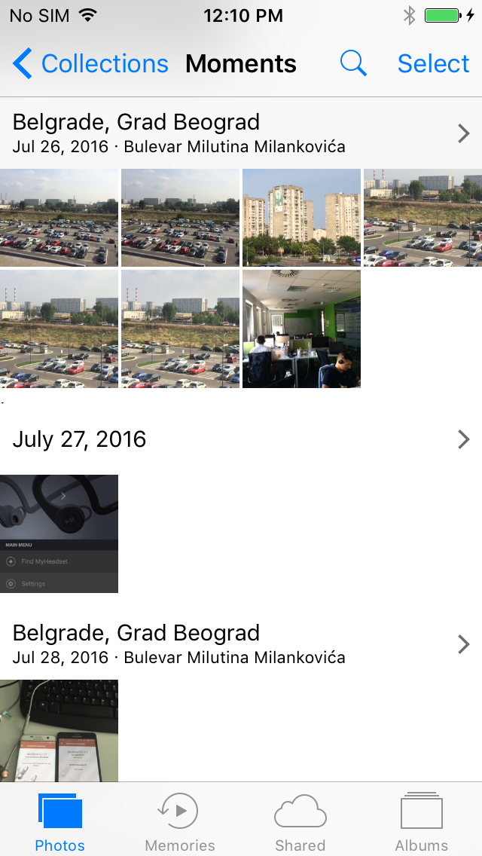
Collection View Controller
Section
Collection view cell
Header – supplementary element

Slide 43
Collection View Controller
UICollectionview DAtasource
There are three important methods in the datasource protocol that provide us:
The number of section (default is one)
func numberOfSections(in collectionView: UICollectionView) -> Int
The number of items in section in the collection
func collectionView(_ collectionView: UICollectionView, numberOfItemsInSection section: Int) -> Int
The UIView to use to draw each cell
func collectionView(_ collectionView: UICollectionView, cellForItemAt indexPath: IndexPath) -> UICollectionViewCell

Slide 44
collection View Controller
UICollectionview Delegate
The delegate reacts to user actions, provides permissions and observes what the collection view is doing. Some examples:
Action - selection of the item
func collectionView(_ collectionView: UICollectionView, didSelectItemAt indexPath: IndexPath)
Permission – selection of the item
func collectionView(_ collectionView: UICollectionView, shouldSelectItemAt indexPath: IndexPath) -> Bool
Observation – the item is no more highlighted
func collectionView(_ collectionView: UICollectionView, didUnhighlightItemAt indexPath: IndexPath)

Slide 45
collection View Controller
UICollectionview layout
Collection view has a layout object which is responsible for the size, position and several other attributes of the content.
Layout objects are subclasses of UICollectionViewLayout.
UICollectionViewLayout can be subclassed in order to create custom layouts, but Apple has provided a basic “flow-based” layout called UICollectionViewFlowLayout.

Slide 46
collection View Controller
UICollectionview FLOW layout deletage
We can tweak a flow layout appearance by implementing UICollectionViewDelegateFlowLayout
protocol:
Size of the item
func collectionView(_ collectionView: UICollectionView, layout collectionViewLayout: UICollectionViewLayout, sizeForItemAt indexPath: IndexPath) -> CGSize
Section insets
func collectionView(_ collectionView: UICollectionView, layout collectionViewLayout: UICollectionViewLayout, insetForSectionAt section: Int) -> UIEdgeInsets
… and many more

Slide 47
agenda
INTRODUCTION
NAVIGATION View controller
Split view controller
Tab BAR controller
Table view controller
Collection view controller
Page view controller

Slide 48
PAGE View Controller
What is PAGE VIEW CONTROLLER?
Why DO we need IT?
What are the benefits of using it?

Slide 49
PAge View Controller
THE concept of PAGE View controller
Page view controller is used to present content in a page-by-page manner.
It is well suited for presenting content that is accessed in a linear fashion (e.g.text of a novel) or for presenting content that has natural page breaks (e.g. calendar).

Slide 50
page VIEW cONTROLLER
PAGE VIEW CONTROLLER’s components
View controller management
Appereance
self.viewControllers
An array of UIViewController managed by page VC
self.setViewControllers(viewControllers: [UIViewController], ...)
Set visibile VCs, optionaly with animation
self.gestureRecognizers
An array of UIGestureRecognizer – these recognizers let the users turn the pages by tapping, flicking and dragging
isDoubleSided
true, false
self.spineLocation
none, min, min, max
self.navigationOrientation
horizontal or vertical
self.transitionStyle
pageCurl or scroll
TXT

Slide 51
PAGE View Controller
UIpageviewcontrolleR DATASOURCE
Provide the view controller that will come from the right (for horizontal orientation)
func pageViewController(_ pageViewController: UIPageViewController, viewControllerAfter viewController: UIViewController) -> UIViewController?
Provide the view controller that will come from the left (for horizontal orientation)
func pageViewController(_ pageViewController: UIPageViewController, viewControllerBefore viewController: UIViewController) -> UIViewController?
The number of dots for page indicator
* func presentationCount(for pageViewController: UIPageViewController) -> Int
The index of page indicator to be selected
* func presentationIndex(for pageViewController: UIPageViewController) -> Int
* Not applicable in some presentation styles

Slide 52
PAge View Controller
UIpageviewcontrolleR DELEgATES
Sent when a gesture-initiated transition begins
func pageViewController(_ pageViewController: UIPageViewController, willTransitionTo pendingViewControllers: [UIViewController])
Sent when a gesture-initiated transition ends
func pageViewController(_ pageViewController: UIPageViewController, didFinishAnimating finished: Bool, previousViewControllers: [UIViewController], transitionCompleted completed: Bool)
… and many more
Notes:
-

Slide 53
page VIEW CONTROLLER
EXAMPLE 6
ebook

Slide 54
RESOURCEs
View Controllers
https://developer.apple.com/library/content/featuredarticles/ViewControllerPGforiPhoneOS
https://developer.apple.com/library/content/documentation/WindowsViews/Conceptual/ViewControllerCatalog
Table view controller
https://www.raywenderlich.com/136159/uicollectionview-tutorial-getting-started
Collection view controller
https://developer.apple.com/library/content/referencelibrary/GettingStarted/DevelopiOSAppsSwift/CreateATableView.html
https://www.raywenderlich.com/136159/uicollectionview-tutorial-getting-started
https://www.raywenderlich.com/136161/uicollectionview-tutorial-reusable-views-selection-reordering

Slide 55
Additional RESOURCEs
Key Value Observing pattern (KVO)
https://cocoacasts.com/key-value-observing-kvo-and-swift-3/
Notification center
http://dev.iachieved.it/iachievedit/notifications-and-userinfo-with-swift-3-0/
https://medium.com/swift-programming/swift-nsnotificationcenter-protocol-c527e67d93a1#.146u7z5op

Slide 56
Petar Cvijić
iOS developer
petar.cvijic@endava.com

